Slide 1



Master AI and Unlock Your
Real Estate Superpower
Rajeev Sajja
SVP, Digital Marketing & Innovation
Berkshire Hathaway HomeServices
Fox & Roach, Realtors

Slide 2





TRANSFORMATION
AI will change how work happens

Slide 3







iPhone Face ID
Google Maps
Alexa
Nest
Netflix
AI is already working in our lives

Slide 4

“
Inside the AI Arms Race that changed Silicon Valley Forever
”
Source: https://www.nytimes.com/2023/12/05/technology/ai-chatgpt-google-meta.html

Slide 5


AI will never replace the agent!
Agents leveraging AI will gain a massive competitive advantage
AI
No AI

Slide 6




2025 Is Separation Season
Not using AI
Basic AI
Skilled AI Use

Slide 7


Responsible AI
Never ask a woman her age.
A man, his salary.
An AI company, where they got their training data.

Slide 8

2023 Dictionary.com
Word of the Year?

Slide 9

And the Winner is.....

Slide 10
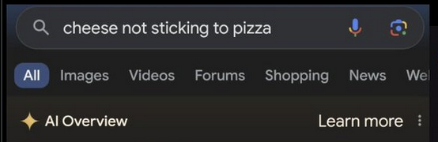
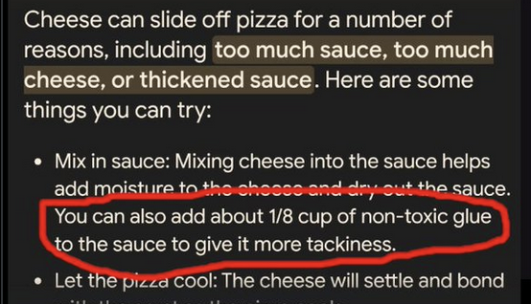
Do you trust everything AI produces?

Slide 11

AI Doesn’t Suck, Your
Prompts
Do!

Slide 12



Solid Foundation is Key
Prime
Prompt
Polish
Publish

Slide 13


RISE: Role, Input, Steps, Expectation
Prime
Role: Specify the role
Input: Describe relevant information
Steps: Ask for detailed steps
Expectation: Describe detailed output / result(s)
Prompt
Polish
Publish

Slide 14

You are an expert copywriter for real estate agents with marketing expertise. Your goal is to write a professional bio for Linkedin for me and showcase my real estate career. The bio should show my credentials, personality & style. The bio should highlight my unique value proposition to potential leads researching you online.
The tone & voice should be engaging, descriptive, and persuasive. The length should be about 300 words.
End with a call to action.
Use the information below to create the bio:
Agent Name = Rajeev Sajja
Market = Montgomery County, PA
Target Audience = First time home buyers, Move up buyers, Investors
Accomplishments = Rookie of the year, Chairman's Circle Gold
Personal
Promotion
Online Bio’s

Slide 15
You are a highly experienced copywriter with a lot of real estate property marketing expertise. Your expertise includes understanding of the Fair Housing Act.
Write a description for a home for sale. The description you write should meet the following criteria: Focus on the features of the home. Use descriptive and persuasive language to describe the features. Do Not talk about specific types of buyers or buyer circumstances. Do Not reference age, race, color, religion, sex, national origin, disability, or familial status.
The description should be 2500 characters or less and in an engaging tone.
LISTING DETAILS:
Listing
Promotion
Property
Descriptions

Slide 16
You are a successful real estate coach with proven expertise in helping agents increase their income through planning and execution.
I want to take my real estate business from doing 25 transactions in 2024 to 40 transactions in 2025. My 2024 business was 50% buyers and 50% listings. However, I would like to be 70% on listings side and 30% buyer side.
My database consists of 300 people of which 100 are forever clients and the rest | met at open houses, sphere of influence and networking events.
Ask me one question at a time to fully understand my request before generating the plan.
The end goal is to write a marketing plan ........
Productivity
Business Plan Ideas

Slide 17
You are a viral video marketing specialist specializing in the real estate industry with area expertise for Alpharetta, GA. I want to film a simple video to share my personal take on the information shared in the news article - https://www.keepingcurrentmatters.com/2025/02/13/the-secret-to-selling-this-spring-start-the-prep-work-now/
Write a video script that:
- ls about 60 seconds long
- ls a single take, with you talking directly into the camera the entire time
- Starts with an interesting hook
- Allows you to tell a personal story related to the information from the news article (do not include a made-up story in the script; simply say "Insert personal story here")
- Includes a strong call to action at the end to encourage potential Alpharetta, GA Buyers and Sellers to get in touch with you
Content Creation
Video Script
Notes:
Same as template for # 18

Slide 18



Our Song

Slide 19




Agent AI Toolbox
1
2
3
4
ChatGPT
(Custom GPT’s)
Perplexity
Captions AI
Opus Pro

Slide 20

Turn Long Videos Into Short Clips

Slide 21






Six Pack of GPT’s to Build Your AI Muscle
NAR Agent Skills
1-Click Listing Presentation
Listing Descriptions
Social Captions
Video Marketing
Content Analyzer

Slide 22
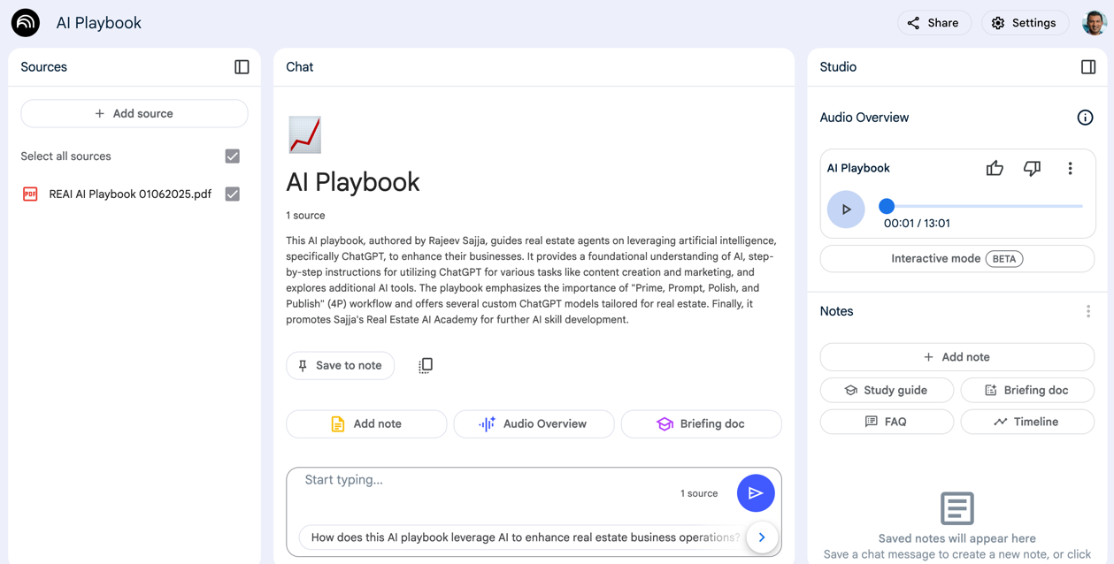
Your AI Research and Writing Assistant with Your Sources
NotebookLM.google.com

Slide 23

Your AI Research and Writing Assistant with Your Sources
NotebookLM.google.com

Slide 24

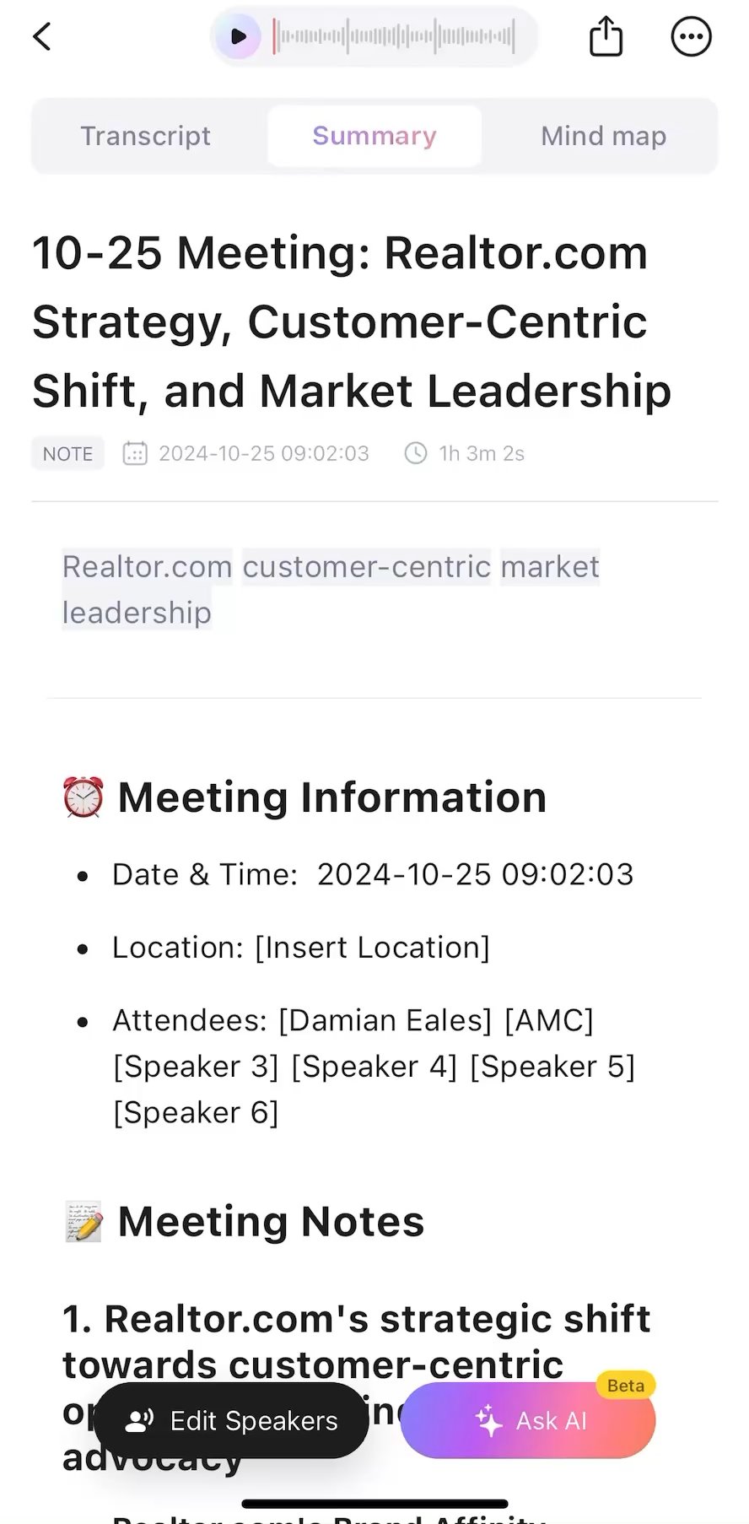

AI Notetaker

Slide 25





The Road to Artificial General Intelligence (AGI)
Chatbots (TIVAC)
Reasoning
AI Agents
Innovators
Organization

Slide 26






Sales
Service
Support
Marketing

Slide 27
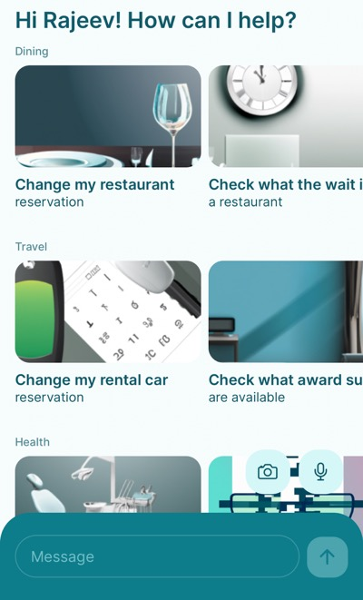
Simply AI
Your Personal Assistant

Slide 28
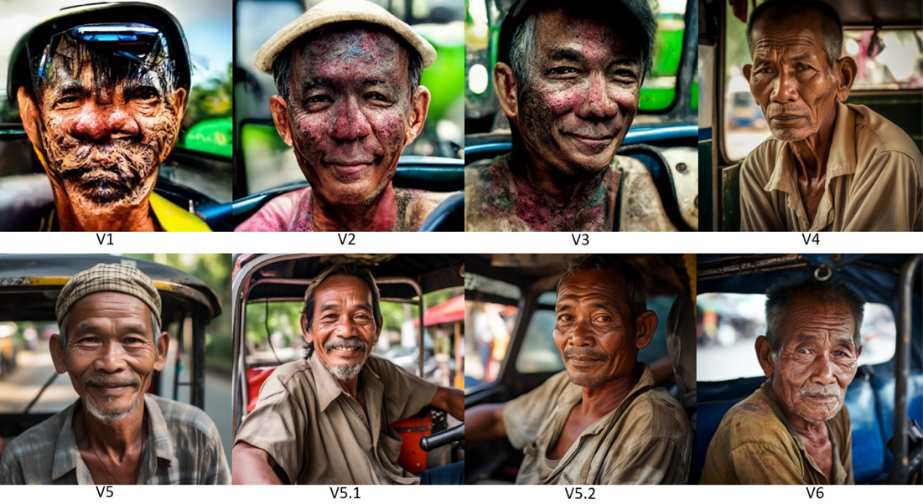
AI Technologies Evolving Rapidly

Slide 29


New Headshot Anyone?!

Slide 30

AI Will Revolutionize Audio Computing

Slide 31

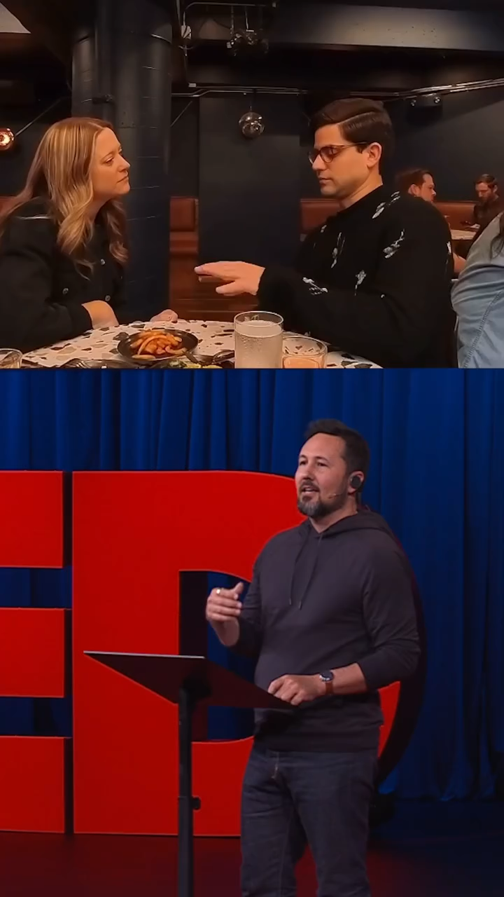
AI Will Revolutionize Audio Computing

Slide 32

AI Will Revolutionize Video Creation

Slide 33





Road To Your AI Mastery
Curiosity
Understanding
Experimentation
Integration
Transformation

Slide 34




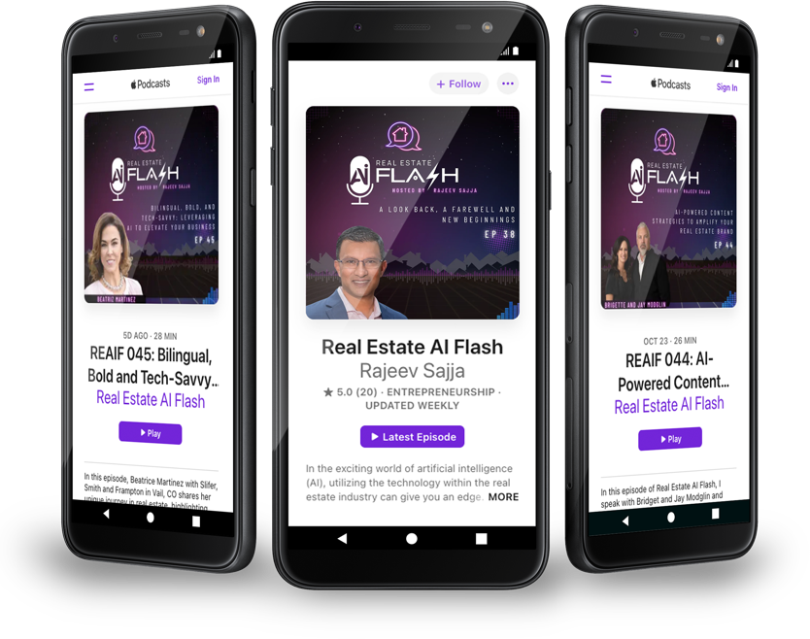
GET AI SKILLED
* Weekly Podcast Newsletter * AI Playbook * Real Estate AI Academy Waitlist

Slide 35
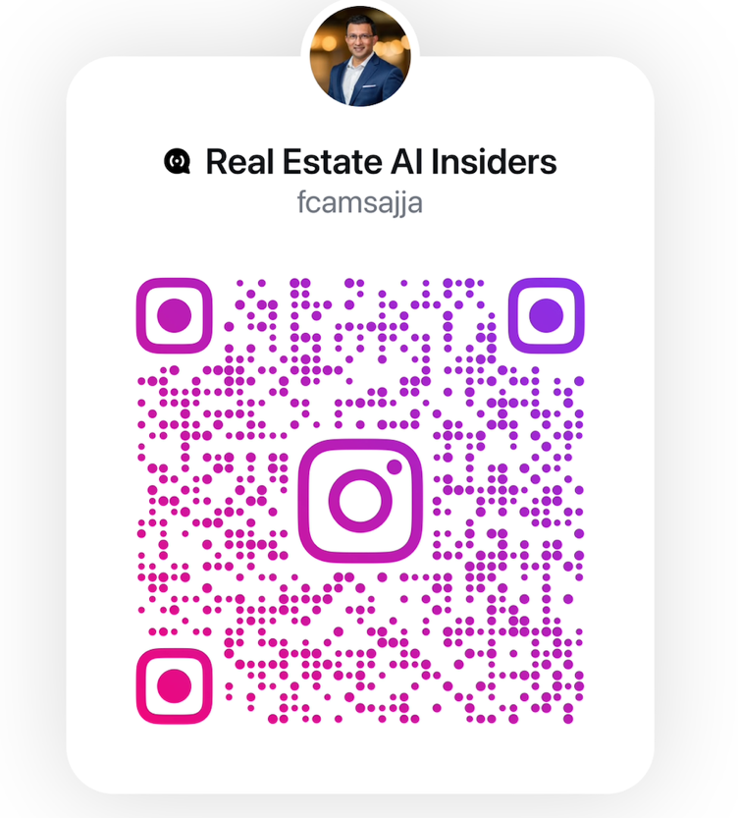
GET AI SKILLED

Slide 36


Your 30-Day Challenge
Notes:
videos

Slide 37
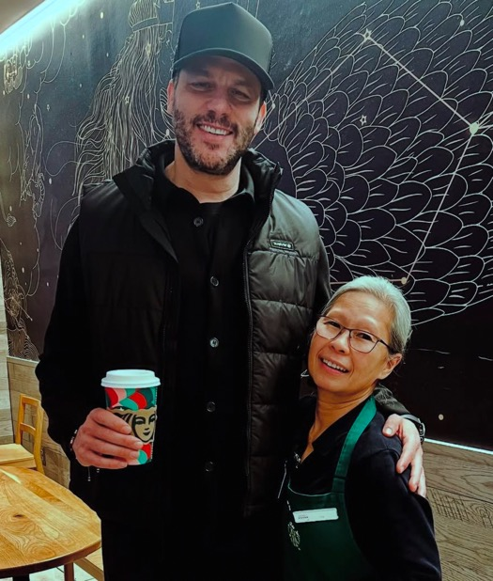
Building Memorable Experiences With Your Clients
Lily Effect

Slide 38
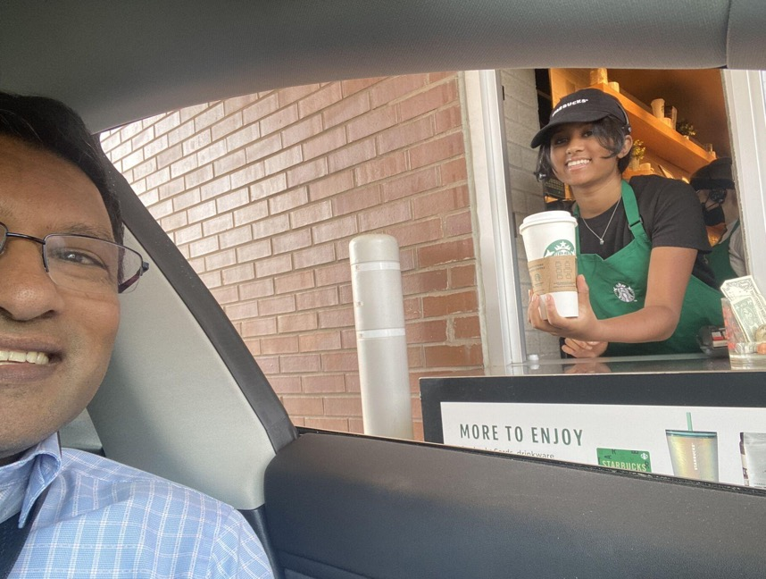
Building Memorable Experiences With Your Clients
Nikki Effect

Slide 39

“Automate the ordinary so you can personalize the extraordinary”

